Slide 1
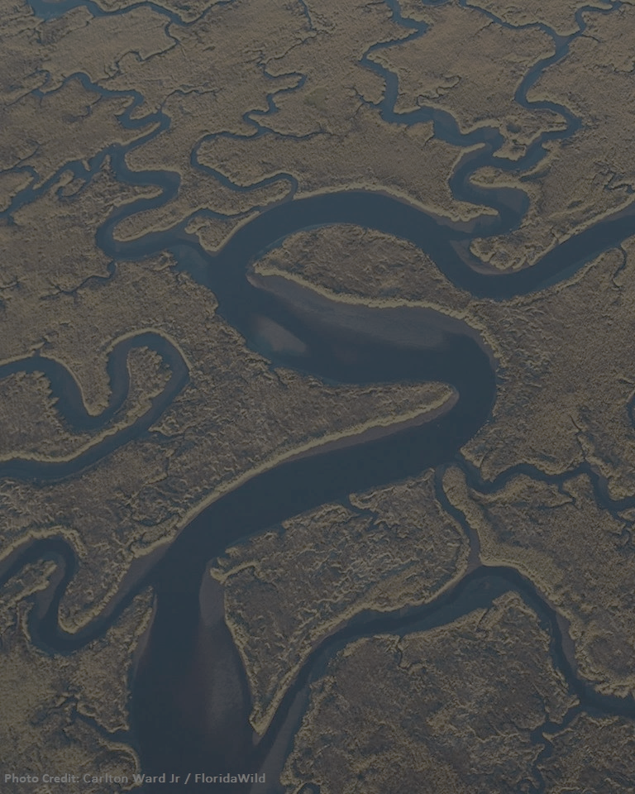



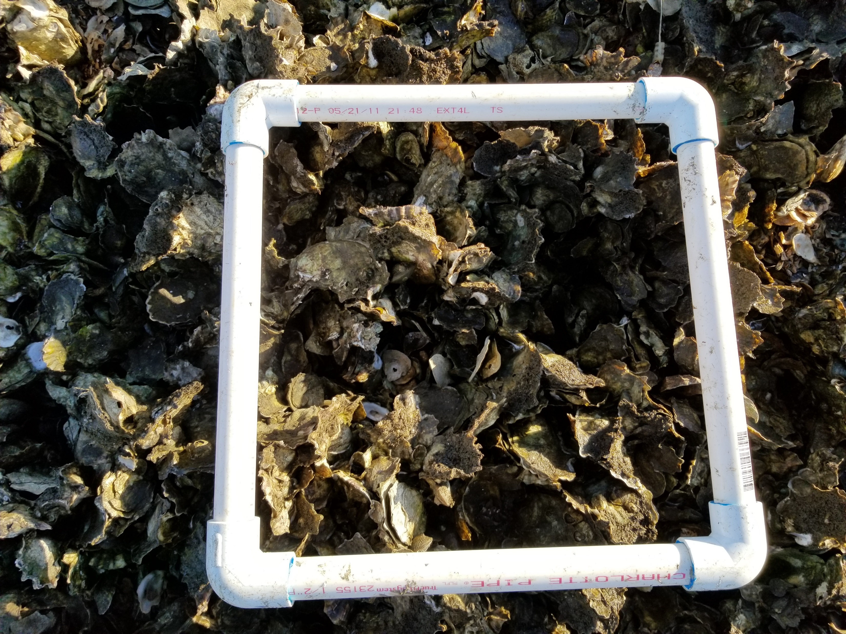

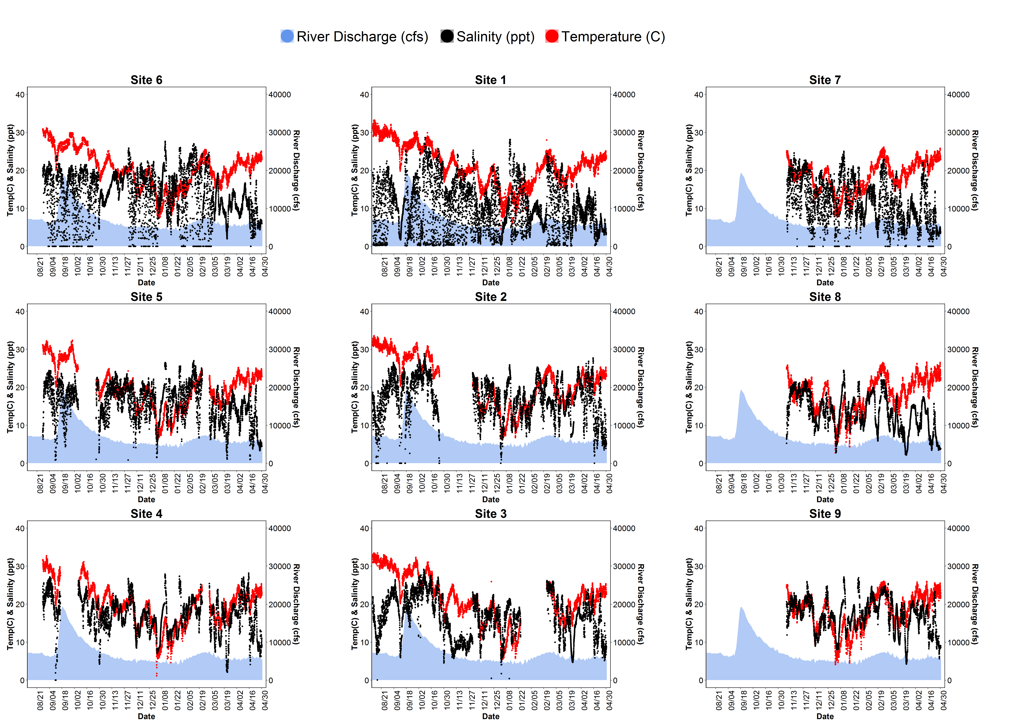
Big Changes in the Big Bend:
A Data Management Story
Data Collection
Decision Making
Discussion
Synthesis
QA/QC
Version Control
Analysis
References

